Slide 1

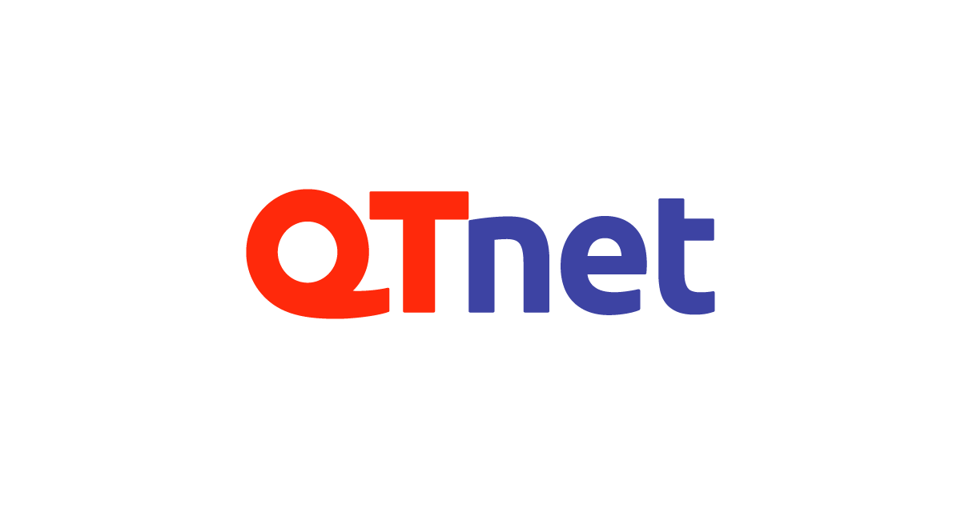


New Investors
※There are also other individual investors
AI image analysis is one of AI's strongest areas of expertise and is used for many applications such as face recognition and inspection. We are confident that the pathology support tool using AI image analysis will reduce the burden of pathologists and contribute to solving the shortage of pathologists in the world, and as an IT company based in Kyushu, QTnet will support Medmain Inc., which is expanding its activities from Kyushu to the world.
Qtnet Inc.
President Kazuto Iwasaki
I am very happy to join the support team of Medmain Inc., which has the potential to go global from Japan. With the expansion of AI diagnostic support, we can expect to shorten the time it takes for diagnostic results. We can also expect it will solve the social problem of the shortage of pathologists and bring a digital formulation of the medical industry. I would like to support the team which updates the existing industry.
Hike Ventures, LLC
General Partner Takahiro Shoji
We decided to invest in Medmain Inc., not only because of its unique AI development capabilities, but also because of its network of medical institutions and pathologists. President Iizuka has medical / AI knowledge and management sense. They have a group of talented and motivated members specialize in management, development, sales and medicine at Medmain. We look forward to future business development to further expand our AI pathology imaging services.
Innovations and Future Creation Inc / MIRAI SOUZOU
Partner Yumiko Nagatsuma

